Slide 2
Intro
Program Language:
C#: GUI Design
C: MCU application
My Job responsibilities:
Design GUI and ATE Tool
Digital verification: FPGA or Simulation
MCU Application for DUT test (I2C/SPI/GPIO/PWM)
FPGA Application

Slide 3
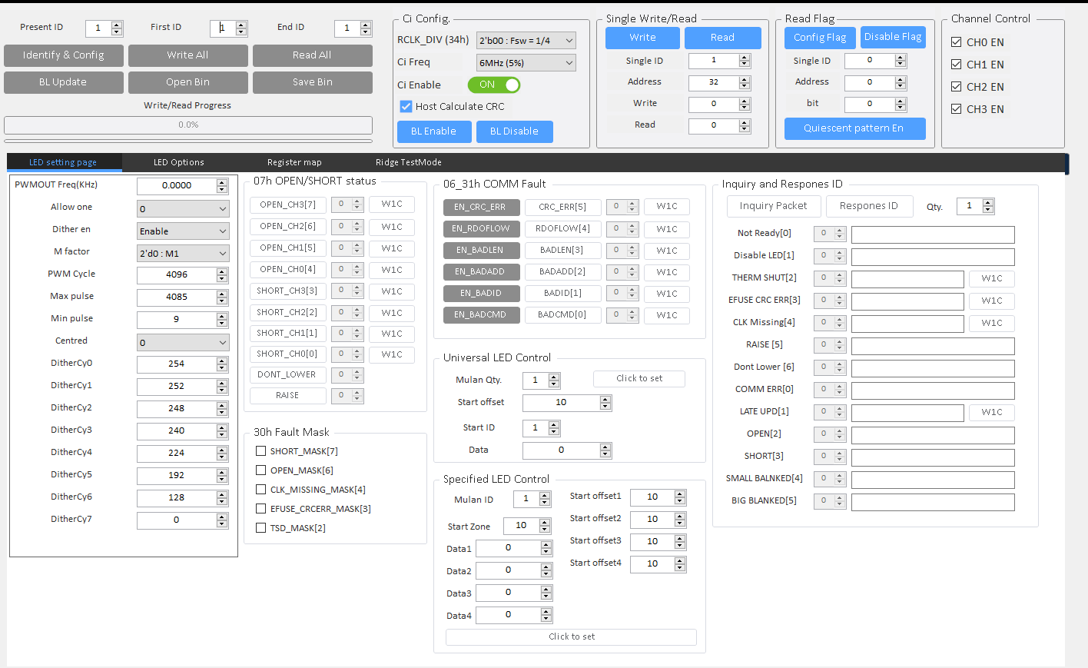
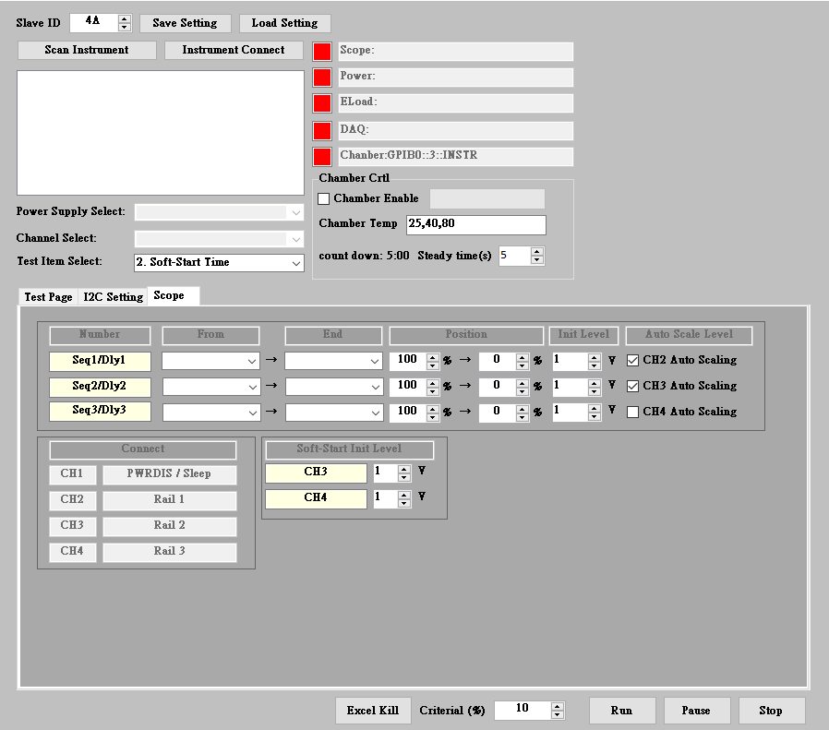
GUI / ATE Design

Slide 4
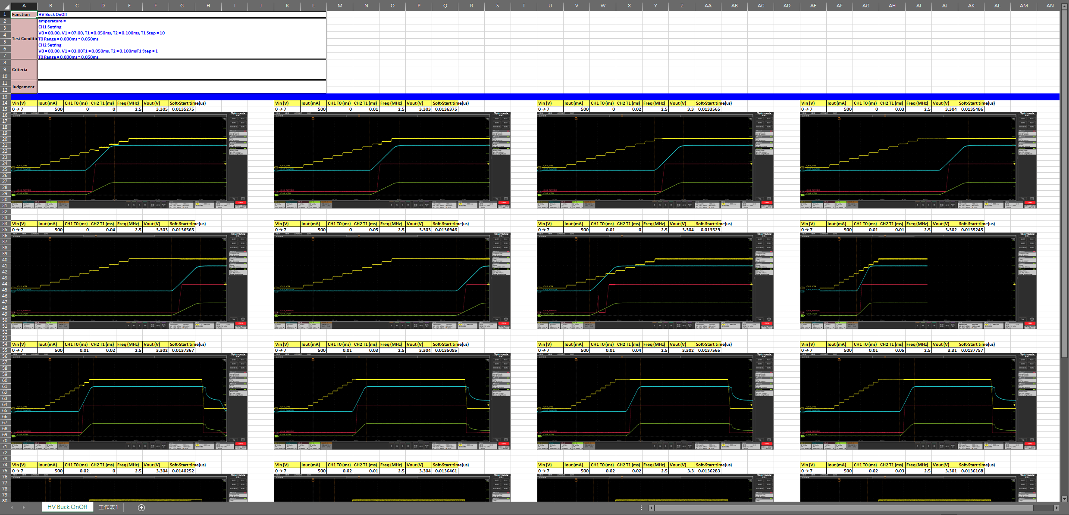
ATE TEST Result

Slide 5
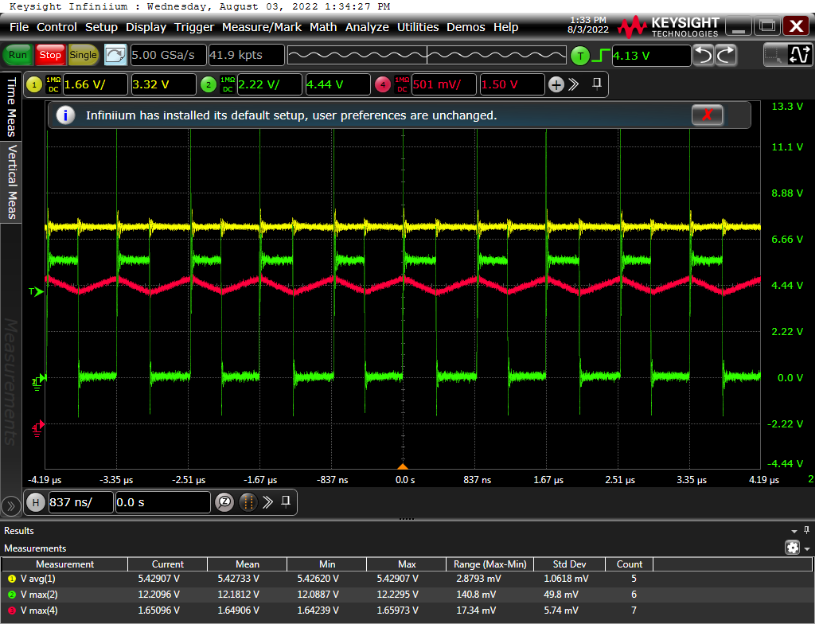
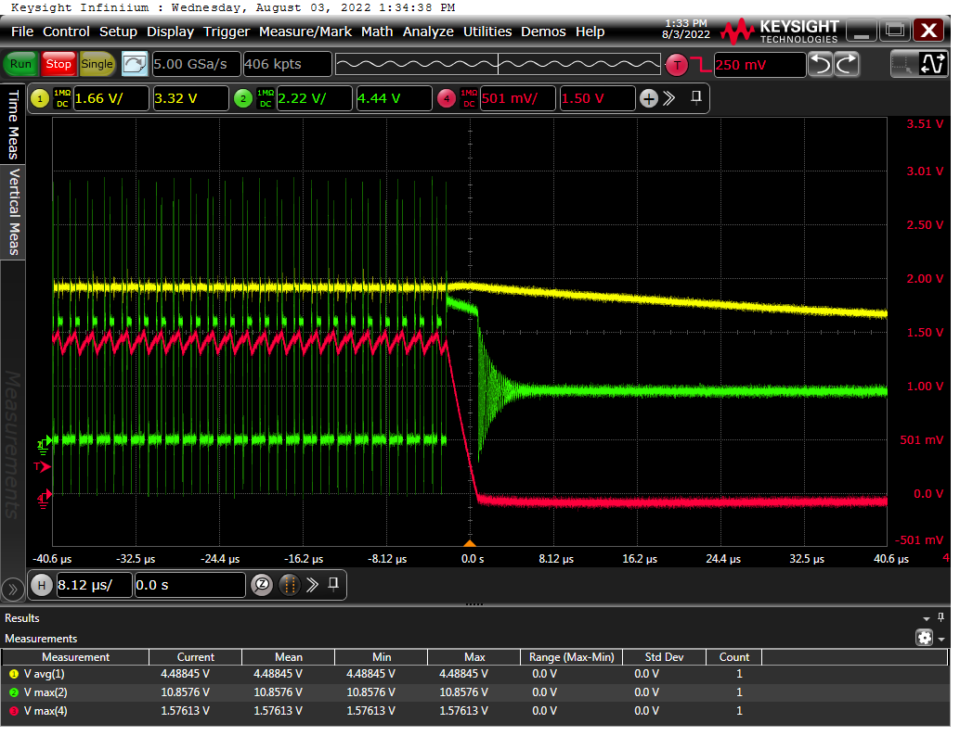
ATE TEST Result
waveform result
OCP
OCP then Power off

Slide 6
Digital Verification
TEST Flow:
Study Spec
Test Plan
Write test pattern
Check spec and co-Work with DRD
Test report review

Slide 7
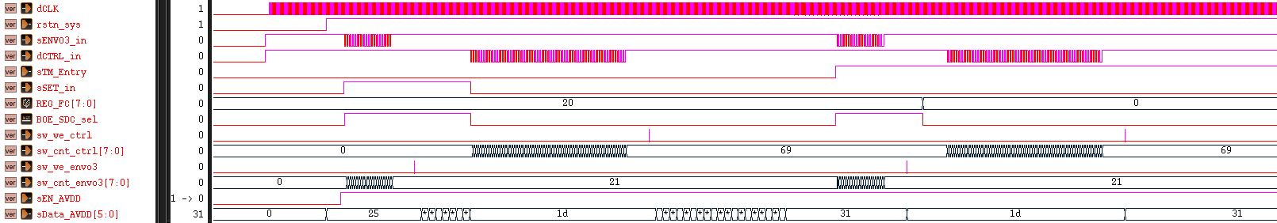
Digital Verification
Simulation (DRD)
Item1 : Add I2C register 0xFC[5](‘0’ BOE, ‘1’ SDC(default)) for mode select. In normal mode control by sSET_in, in test mode control by 0xFC[5].
normal mode
test mode

Slide 8
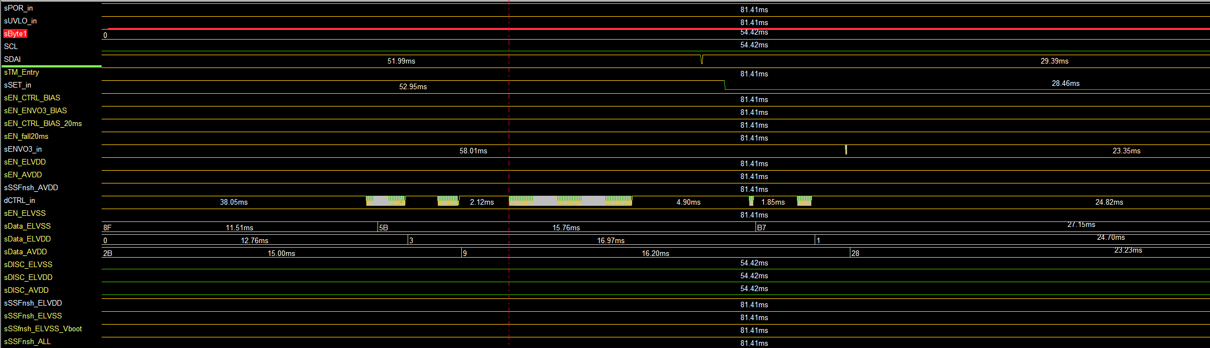
Digital Verification
Simulation (FPGA)
Item1 : Add I2C register 0xFC[5](‘0’ BOE, ‘1’ SDC(default)) for mode select. In normal mode control by sSET_in, in test mode control by 0xFC[5].
0xFC[5] = 0 (BOE), sSET_in = 1 (SDC) follow BOE swire table
0xFC[5] = 1 (SDC), sSET_in = 0 (BOE) follow SDC swire table

Slide 9
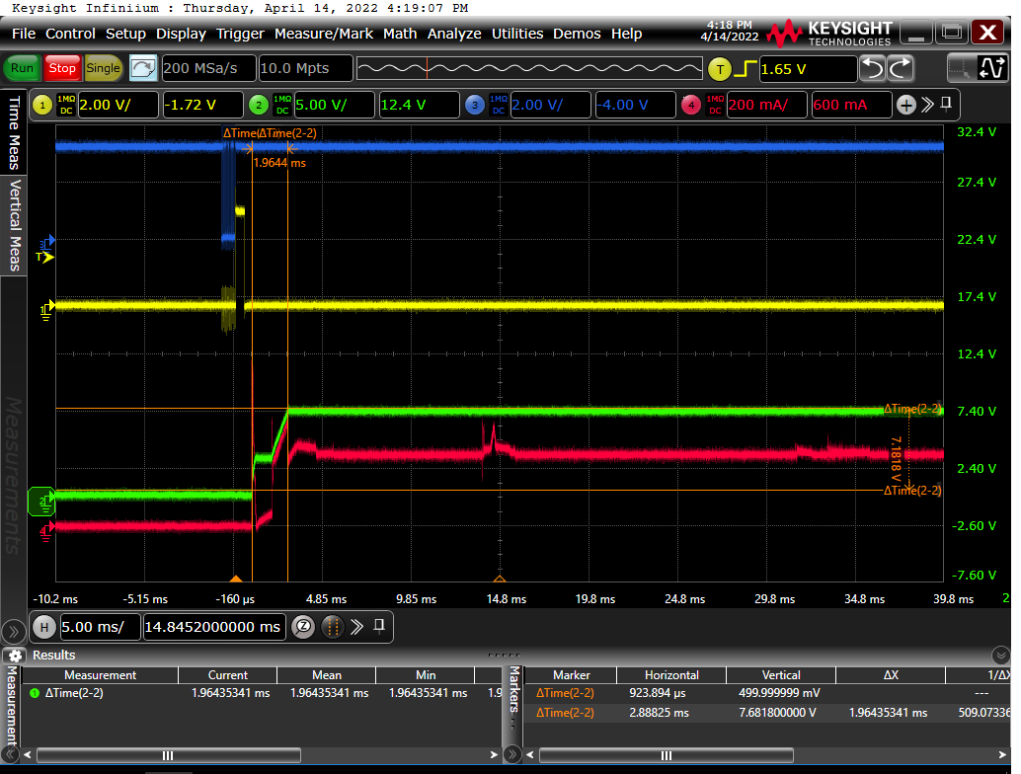
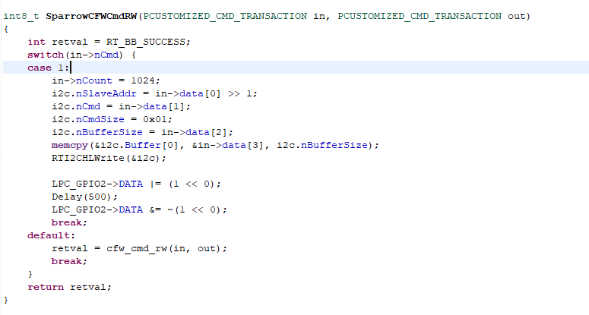
MCU Application
GPIO for scope trigger
Turn on gpio after i2c write

Slide 10
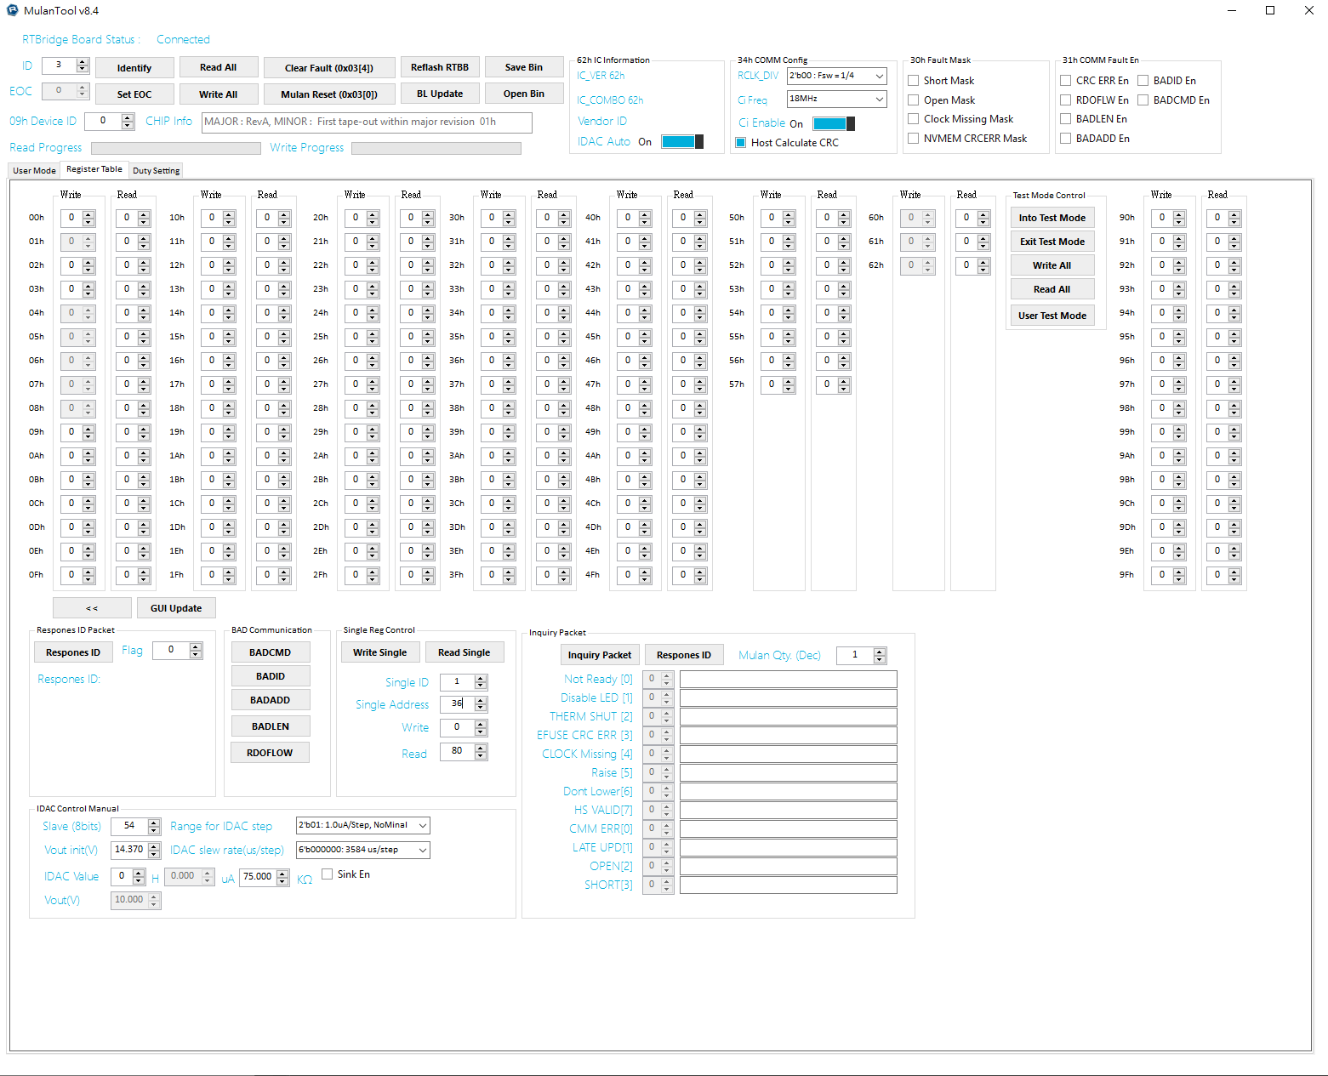

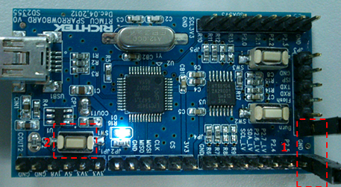
FPGA Application
Architecture
2
SPI Slave FIFO
RAM
Ctrl
OUT
Ctrl
1
4
3
IN
Ctrl
DUT
0
Set RAM content
1
Output test pattern
2
FIFO & RAM control
3
Data Transfer/Receiver to/form DUT
4
Upload Data to Host

Slide 11
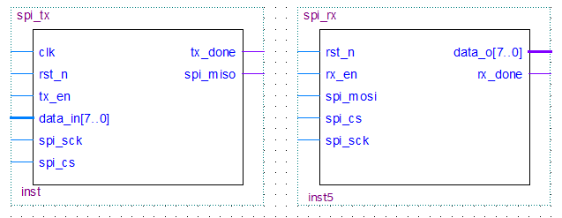
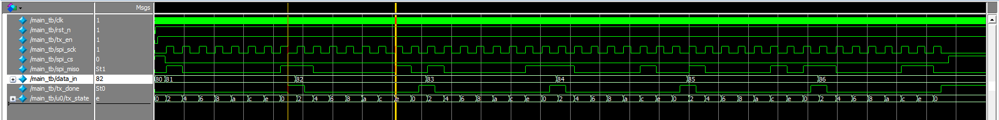
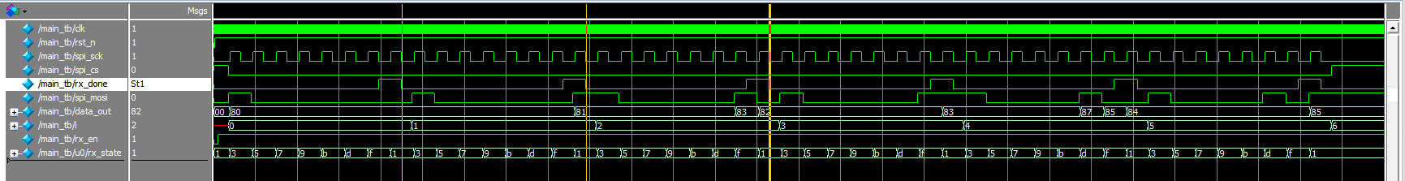
FPGA Application
SPI Tx
SPI Rx
Simulation Tx
8 clk of byte
tx_state = 0, tx_done = 1 (next state go low)
Simulation Rx
8 clk of byte
rx_state = 0x0f, rx_done = 1 (next state go low)

Slide 12
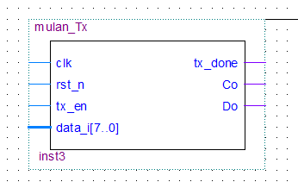
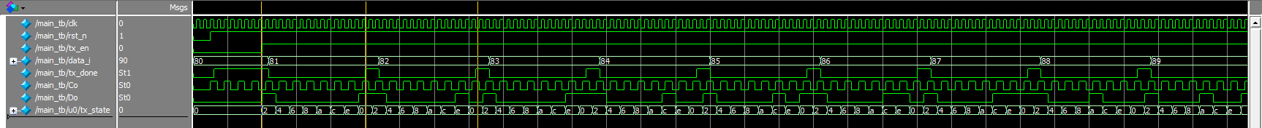
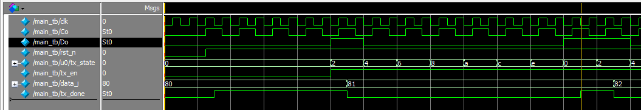
Communication Tx
Do will gen the waveform
Clk falling gen Do state
Co = clk / 2
1
2
3
4
5
6
7
8

Slide 13
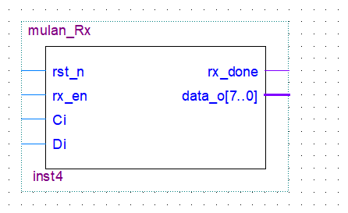
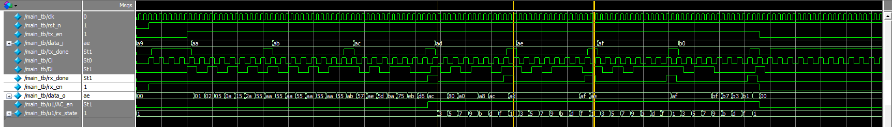
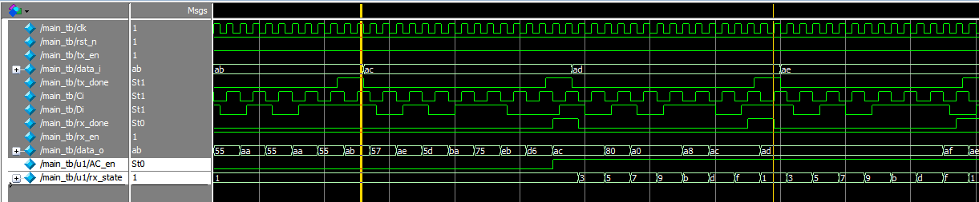
Communication Rx
Di input 0xAC to mulan Rx module
1
2
3
4
5
6
7
8
1
0
1
0
1
1
0
0
rx_done falling trigger fifo

Slide 14
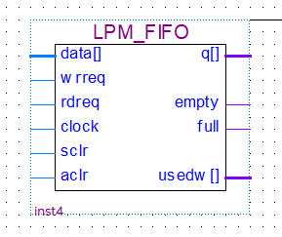
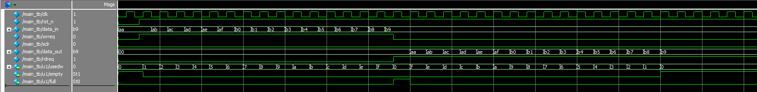
FIFO IP
Rising edge push data to FIFO Queue
Rising edge pop data
Simulation
Full & empty flag
FIFO write enable
FIFO read enable

Slide 15
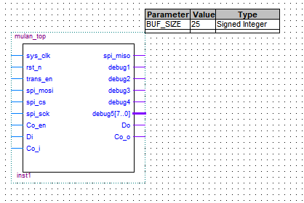
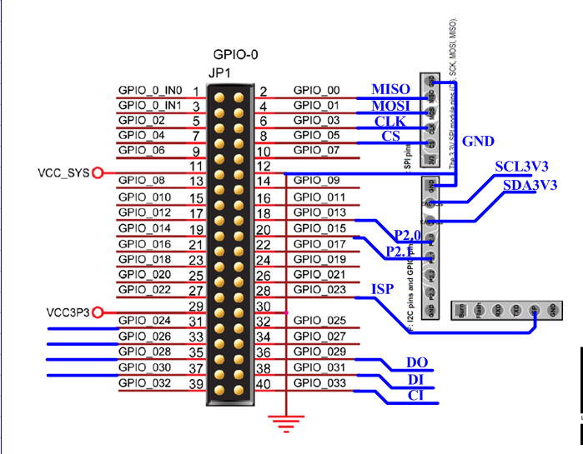
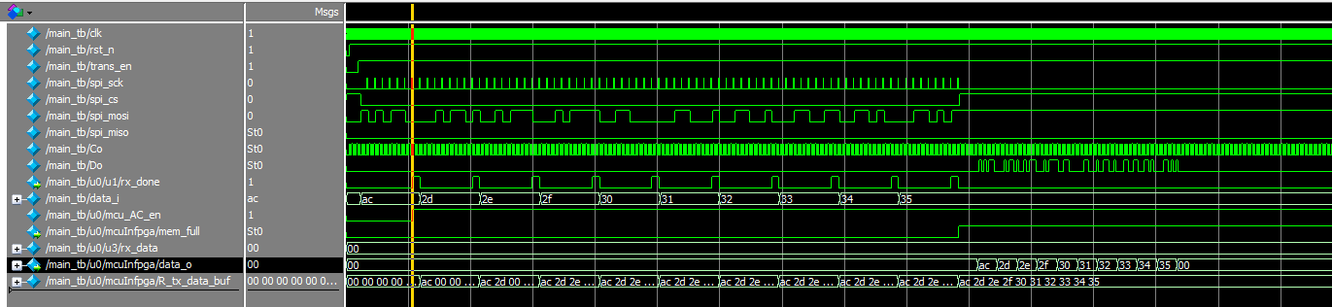
Host Top (Tx simulation)
Pin assignment
simulate MCU spi write
Falling into FIFO buffer
FIFO buffer
Buffer full flag

Slide 16
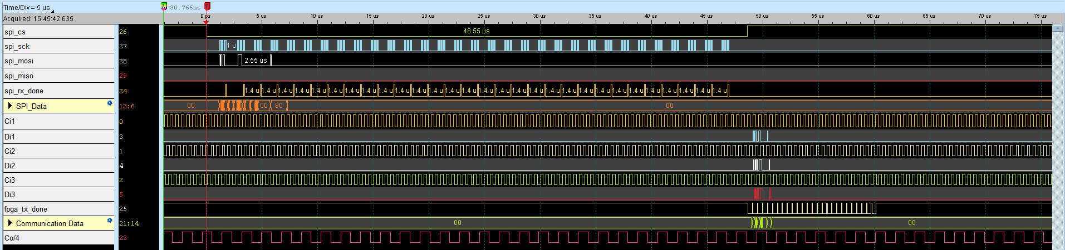
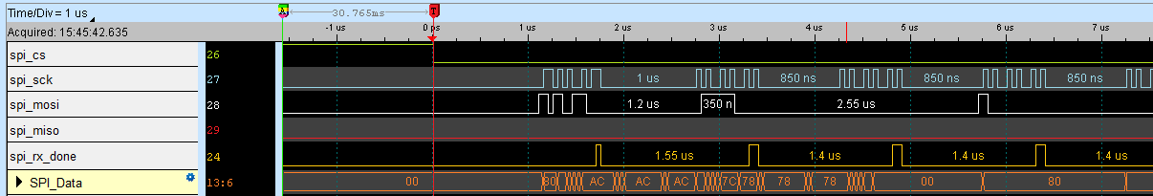
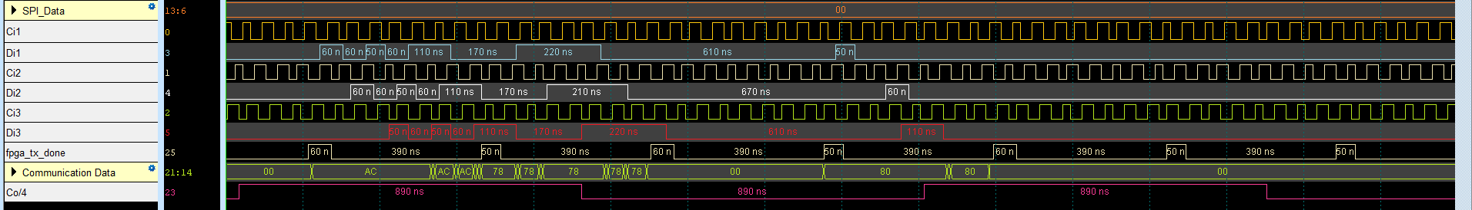
FPGA Application (Tx)
SPI write data to FPGA
SPI Finish
Zoom In SPI write
FPGA write data to device
Zoom In FPGA write
16

Slide 17
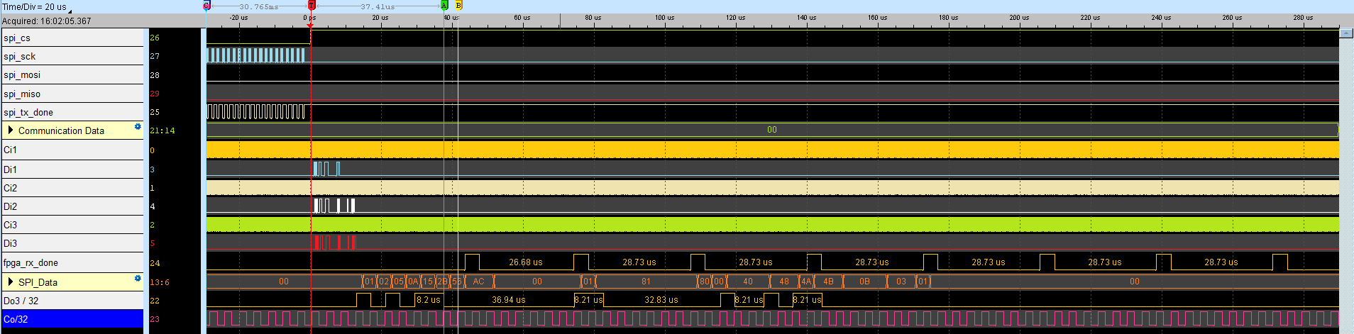
FPGA Application (Rx)
FPGA decode Device data
Device Do will divide RCLK

Slide 18
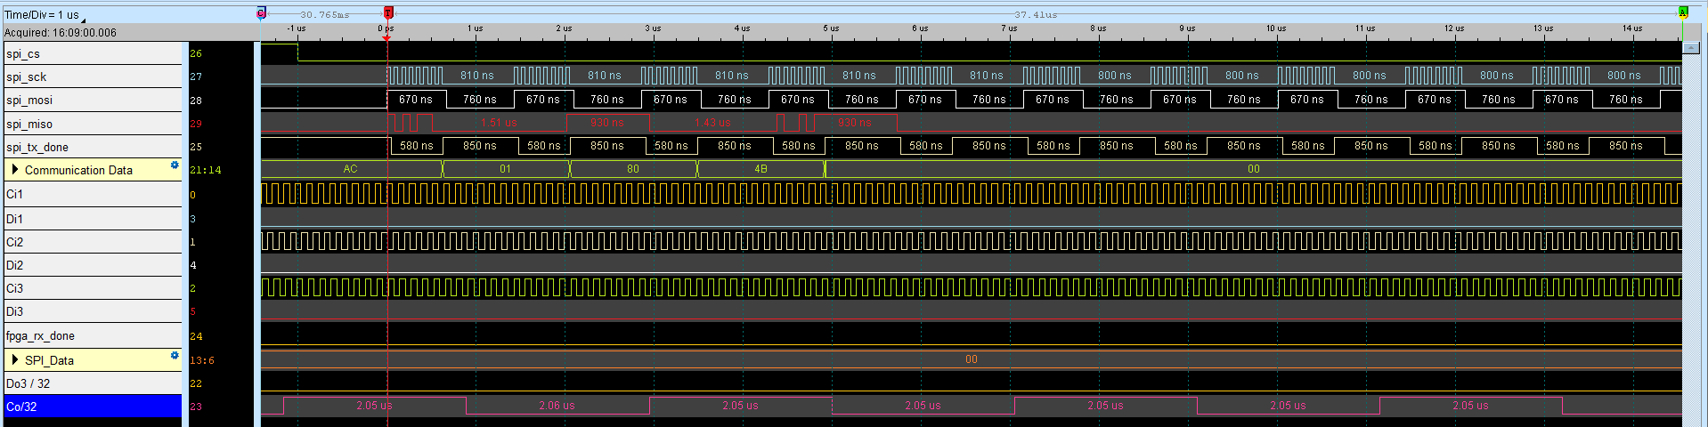
FPGA Application (Rx)
MCU Receiver Data

